Slide 1
Data Augmentation and Segmentation with Generative Networks for Medical Imaging
NVIDIA Deep Learning Institute Approved Instructors NVIDIA Corporation

Slide 2
LAB PERSPECTIVE

Slide 3
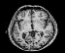
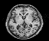
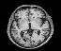
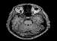
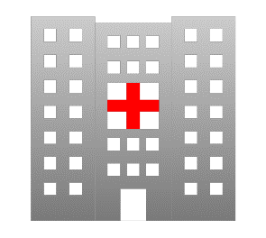
Challenges in developing medical AI
Lack of training data
Due to patient privacy, patient data cannot be easily transferred across different institutions
Need 10,000 brain MRI scans to train a well-performing AI. But hard to collect data due to privacy.
Data are isolated!
PRIVACY
PRIVACY
PRIVACY
Hospital A
Hospital B
Hospital C
…
…
…
Has 3,200 brain MRI scans
Has 5,000 brain MRI scans
Has 800 brain MRI scans
Notes:
One of the most fundamental challenge in developing medical AI is lack of data. Let’s say we need 10,000 brain MRI scans to train a well performing AI. Three hospitals have a few thousand brain MRIs, but these data are isolated and cannot be shared due to patient privacy. That prevents us from collecting large medical image dataset to train AI.

Slide 4


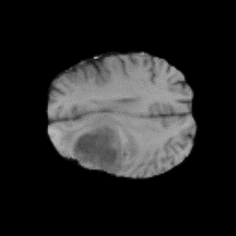
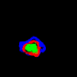
Challenges in developing medical AI
Lack of training data
Rare disease cases are just rare – it is harder to get disease/pathology data than normal data
Getting ground-truth labels for training an AI is difficult
Labeling the data is a time-consuming and expensive task (people who can label the data (medical doctors) are expensive labors!)
Hospital A
Manual labeling by experts
(expensive and time consuming!)
…
Usually, around 80%
of data are normal (ref [1,2])
Has 3,200 brain MRI scans
20% (640) abnormal brain MRI
Only about 40% gets labeled
(ref – BRATS’18[3] challenge data has 285
labeled training data)
[1] https://arxiv.org/abs/1603.08486 [2] https://arxiv.org/abs/1705.02315
[3] http://www.med.upenn.edu/sbia/brats2018.html
Notes:
And even if we collected enough dataset to train AI, we need to annotate them to train supervised learning algorithm which is the most successful way of training an AI. But annotating medial images are costly and time-consuming, even for trained radiologists. And this is the second biggest roadblock in collecting many images for training.

Slide 5
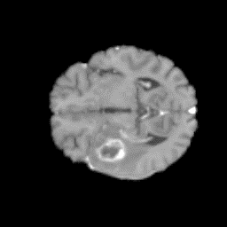
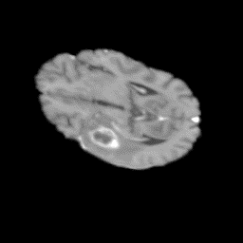
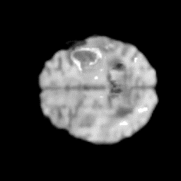
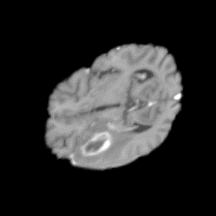
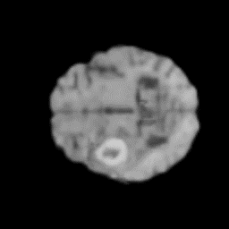
Data augmentation
“usual” data augmentation
“a bit more advanced data augmentation”
“way more advanced data augmentation”
Zoom & crop
Elastic deformation
synthetic
original
Realistic brain, but not too different
from the original
Not realistic brain anymore, if deformed too much
There’s so much you can do elastic deformation
Still realistic, and can generate arbitrary many brain
Images with different attributes/characteristics!
flip
Elastic deformation
synthetic
Notes:
It is very common to use data augmentation in the medical field. Dataset are usualy very limited and for Deep Learning, we need a lot of data.
Traditional augmentation include…
However, what if we could create synthetic data?

Slide 6
QUICK GAN INTRO – Generative Adversarial Networks

Slide 7
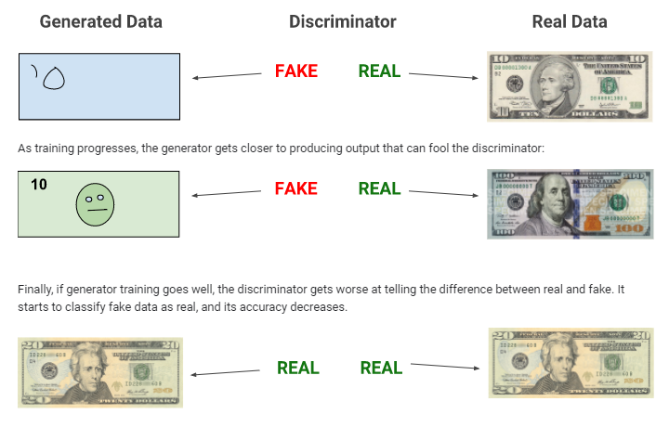
An Approach For Generating Data
Notes:
What we want, is a generator that creates synthetic data.
This synthetic data should look as realistic as possible.
But how can we define “as realistic as possible.
We know some measure to define how close two images are.
But what we really want: our created image should belong to the underlying distribution of the real dataset

Slide 8
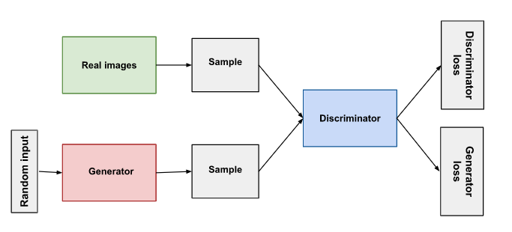
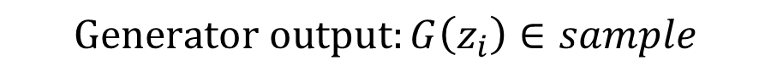
Adversarial Training
$$Generator output:G\left(z_{i}\right)∈sample$$
$$Discriminator output: D\left(x_{i}\right) or D(G\left(z_{i}\right))∈[0,1]$$
Notes:
What we want, is a generator that creates synthetic data.
This synthetic data should look as realistic as possible.
But how can we define “as realistic as possible.
We know some measure to define how close two images are.
But what we really want: our created image should belong to the underlying distribution of the real dataset

Slide 9
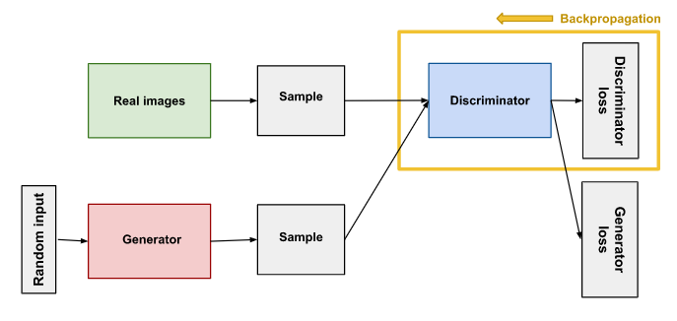
Discriminator Training
$$Logistic regression loss:dL_{i}=−y_{i}\log\left(f\left(x_{i}\right)\right)+\left(1−y_{i}\right)\log\left(1−f\left(x_{i}\right)\right)$$
$$Discriminator loss:−dL_{i}^{D}=−\log\left(D\left(x_{i}\right)\right)−\log\left(1−D\left(G\left(z_{i}\right)\right)\right)$$
Notes:
What we want, is a generator that creates synthetic data.
This synthetic data should look as realistic as possible.
But how can we define “as realistic as possible.
We know some measure to define how close two images are.
But what we really want: our created image should belong to the underlying distribution of the real dataset

Slide 10
Generator Training
$$Generator loss:dL_{i}^{G}=−log⁡(1−D(G\left(z_{i}\right)))$$
Notes:
What we want, is a generator that creates synthetic data.
This synthetic data should look as realistic as possible.
But how can we define “as realistic as possible.
We know some measure to define how close two images are.
But what we really want: our created image should belong to the underlying distribution of the real dataset

Slide 11
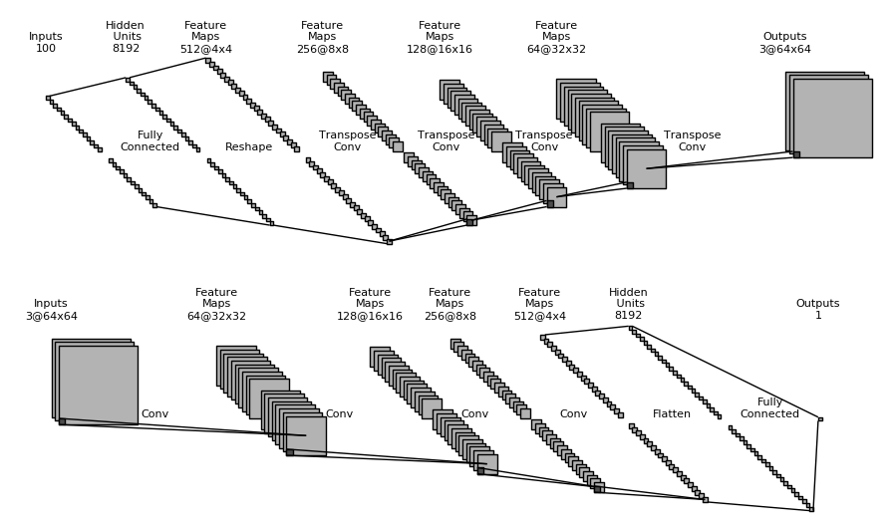
GAN: NETWORK TOPOLOGY
Radford (2015). Unsupervised Representation Learning with Deep Convolutional Generative Adversarial Networks. arXiv:1511.06434
Generator
Discriminator

Slide 12
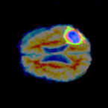
Data Augmentation and Segmentation with GANs for Medical Imaging
Real or fake?
Generator
Synthetic data
Discriminator
Real data
Notes:
The input and output of the networks are very generic.
So instead of a latent random vector, we can also ask the generator to produce a segmentation of the input image.

Slide 13
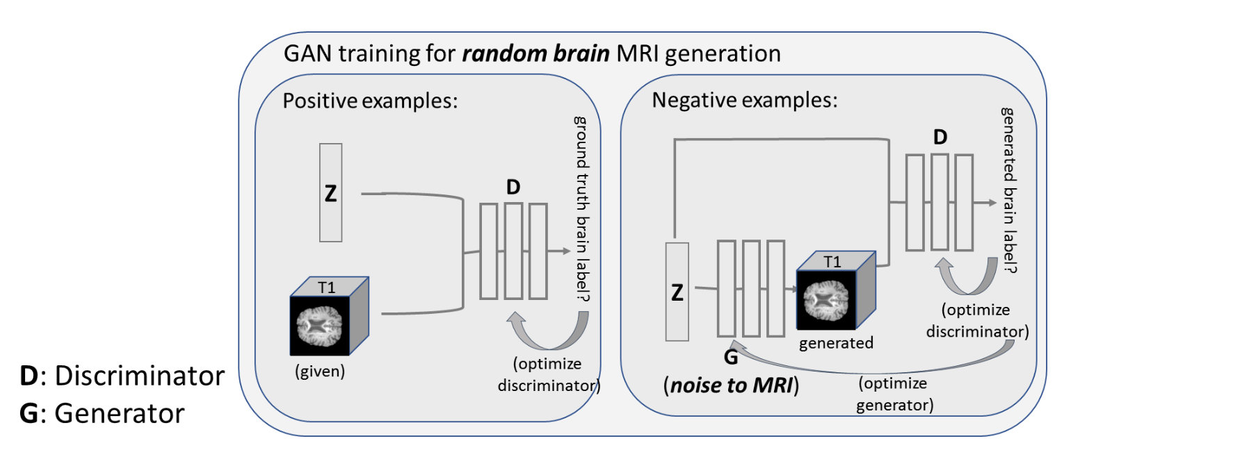
Task 1) Generating random MRI from noise
Notes:
Generative Adversarial Networks (GAN) can be used to generate lots of synthetic images. In the DLI we try a basic GAN to generate many synthetic brain MRI. However, we’d like to have more control than generating random MRIs.

Slide 14
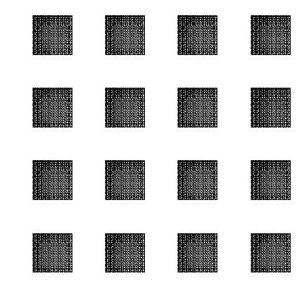
Notes:
Generative Adversarial Networks (GAN) can be used to generate lots of synthetic images. In the DLI we try a basic GAN to generate many synthetic brain MRI. However, we’d like to have more control than generating random MRIs.

Slide 15
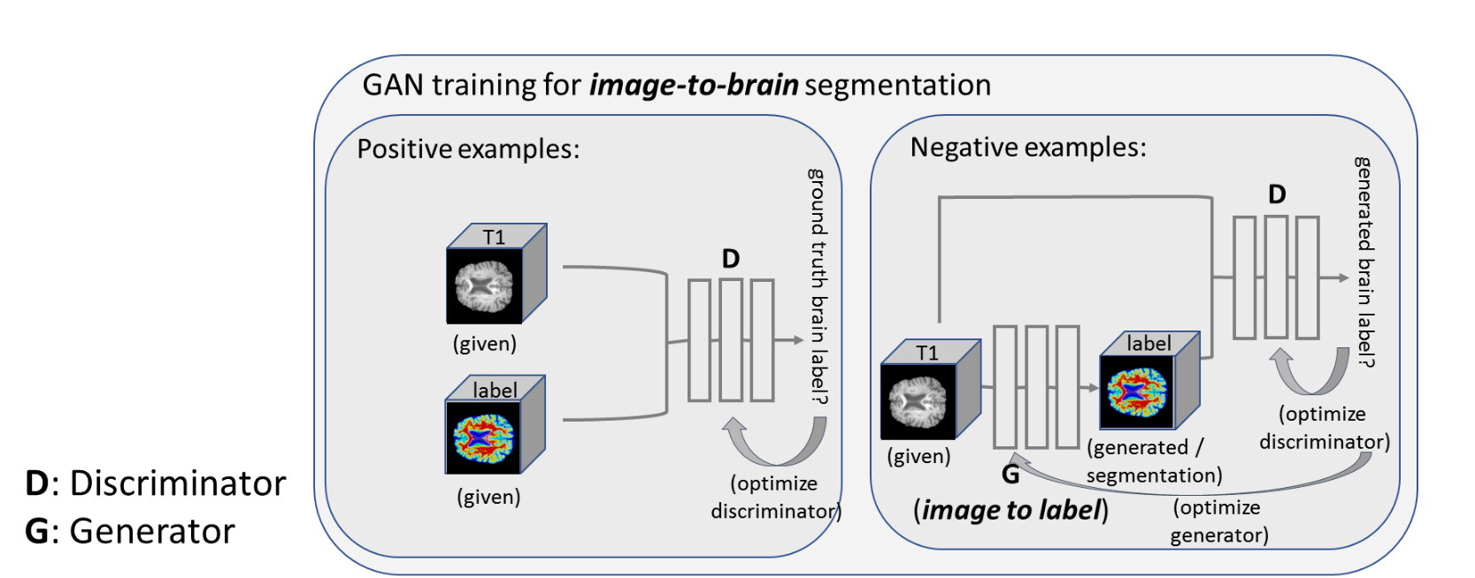
Task 2) Segmenting brain from MRI (pix2pix)
Notes:
Conditional GAN gets an input and outputs a synthetic image based on the input. For example input can be a T1-weighetd brain MRI, and output can be its segmentation into white matter, gray matter and CSF.

Slide 16
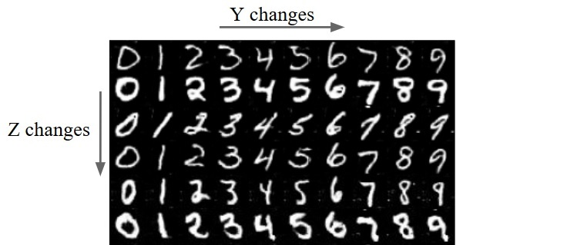
Conditional GAN
Notes:
Conditional GAN gets an input and outputs a synthetic image based on the input. For example input can be a T1-weighetd brain MRI, and output can be its segmentation into white matter, gray matter and CSF.

Slide 17
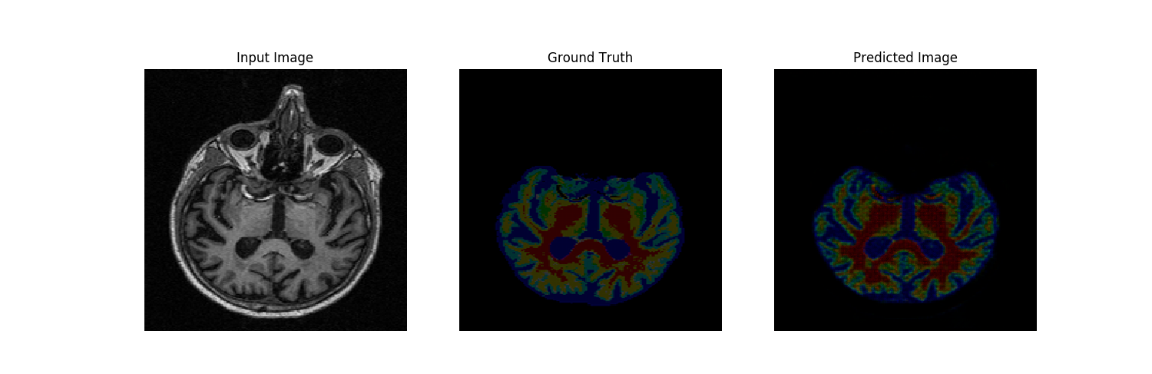
After 1 Epoch
Notes:
Conditional GAN gets an input and outputs a synthetic image based on the input. For example input can be a T1-weighetd brain MRI, and output can be its segmentation into white matter, gray matter and CSF.

Slide 18
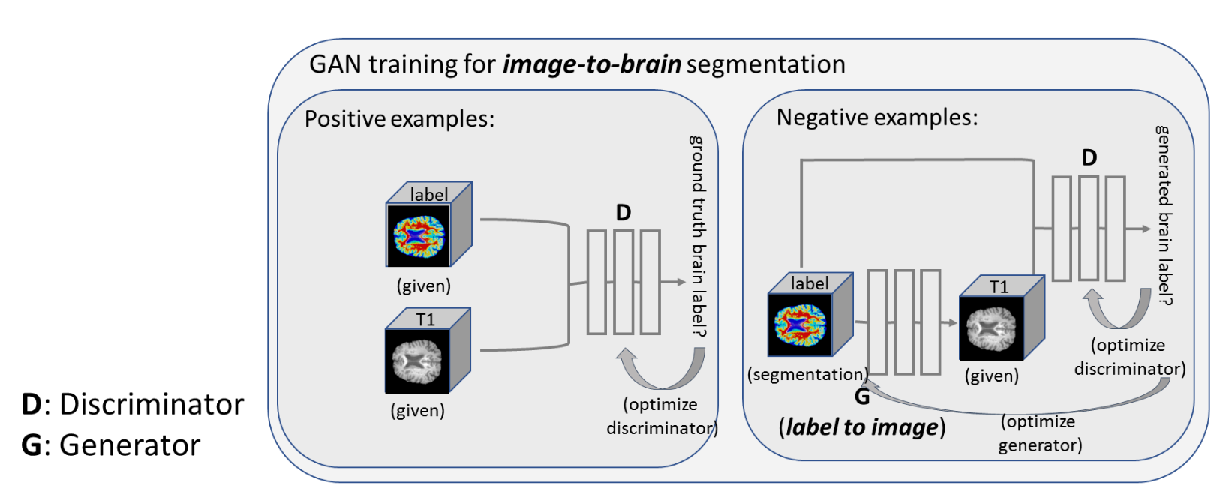
Task 3) MRI from Segmentation (pix2pix)
Notes:
We can use the same conditional GAN to generate synthetic T1-weighted brain MRI from a label map, just by switching the input and output.

Slide 19
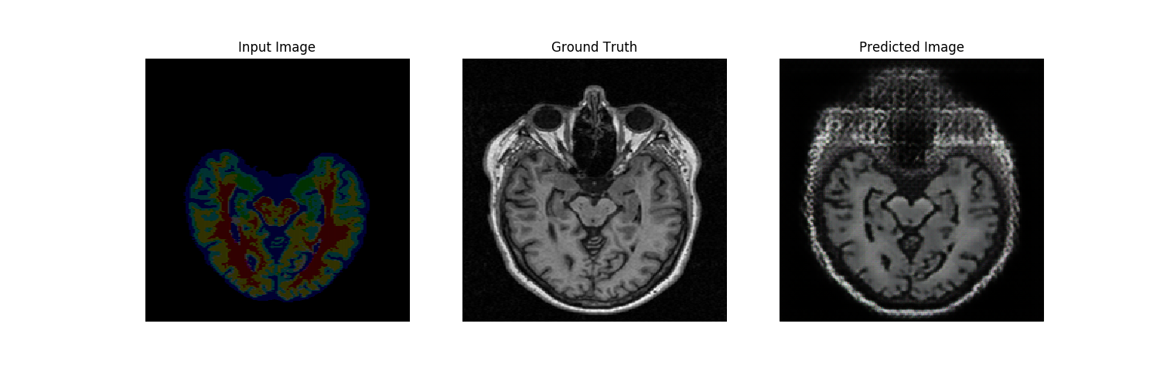
After 1 Epoch
Notes:
We can use the same conditional GAN to generate synthetic T1-weighted brain MRI from a label map, just by switching the input and output.

Slide 20

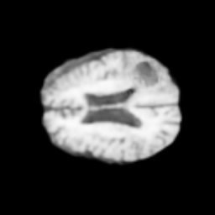
Generate synthetic brain MRI with disease from a label
Label can be modified/human-defined, so we can generate
a lot of medical images
Ground truth annotation is automatically there
No need for (time-consuming/expensive) manual annotation
Notes:
Now that we can generate synthetic brain MRI from label, we can alter the label to generate arbitrary images that we may desire. For instance, say we have a brain MRI with tumor and the label. We can alter the tumor label to generate more synthetic images with tumor.

Slide 21
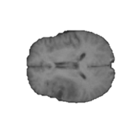
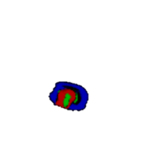
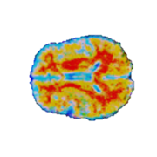
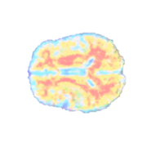
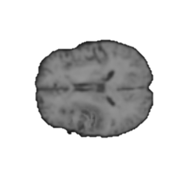
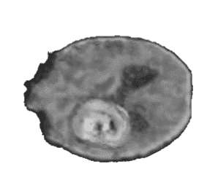
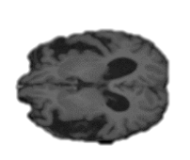
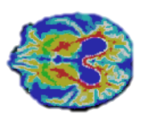
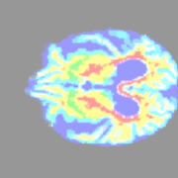
Generate arbitrary (desired) brain MRI with disease (e.g., small, large, place tumor on tumor-free MRI, etc.)
BRATS - T1
Brain atlas - BRATS
(inferred)
Brain + tumor
label (merged)
Synthetically
generated MRI
T1
Infer (G)
Merge
Infer (G)
MRI-to-label
Label-to-MRI
Tumor label - BRATS
(provided)
1) No change
2) Shift location
3) Enlarge
4) Shrink
Brain atlas - ADNI
(inferred)
Brain + tumor
label (merged)
Synthetically
generated MRI
ADNI - T1
T1
Infer (G)
Infer (G)
MRI-to-label
Merge
Label-to-MRI
Notes:
We can shift the location of the tumor, or make the tumor little larger or smaller. Or even we can put tumor on a otherwise tumor-free brain. When we generate synthetic brain MRIs this way, we automatically have ground-truth labels because we create synthetic MRIs from the labels.

Slide 22
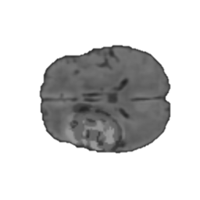
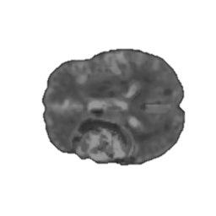
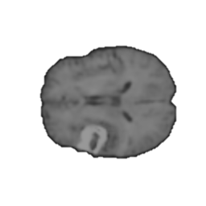
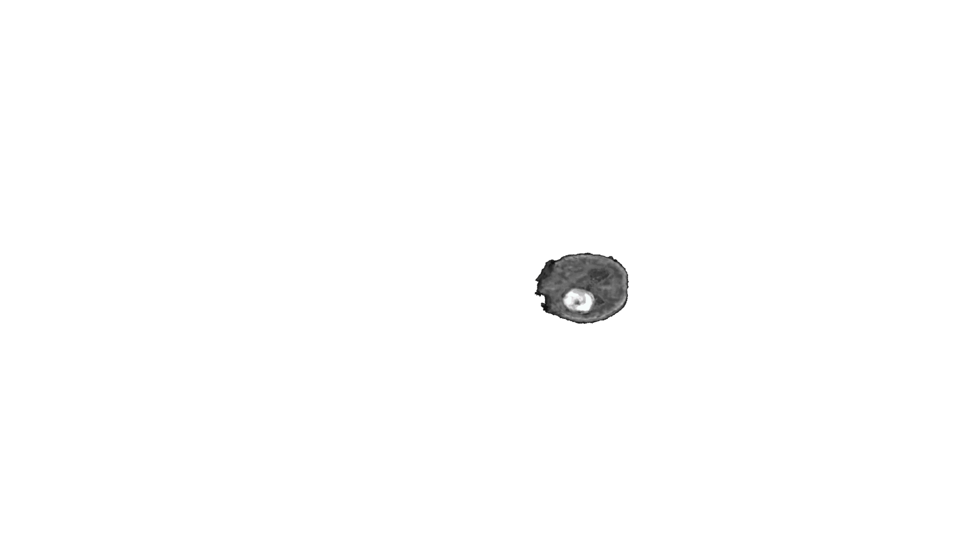
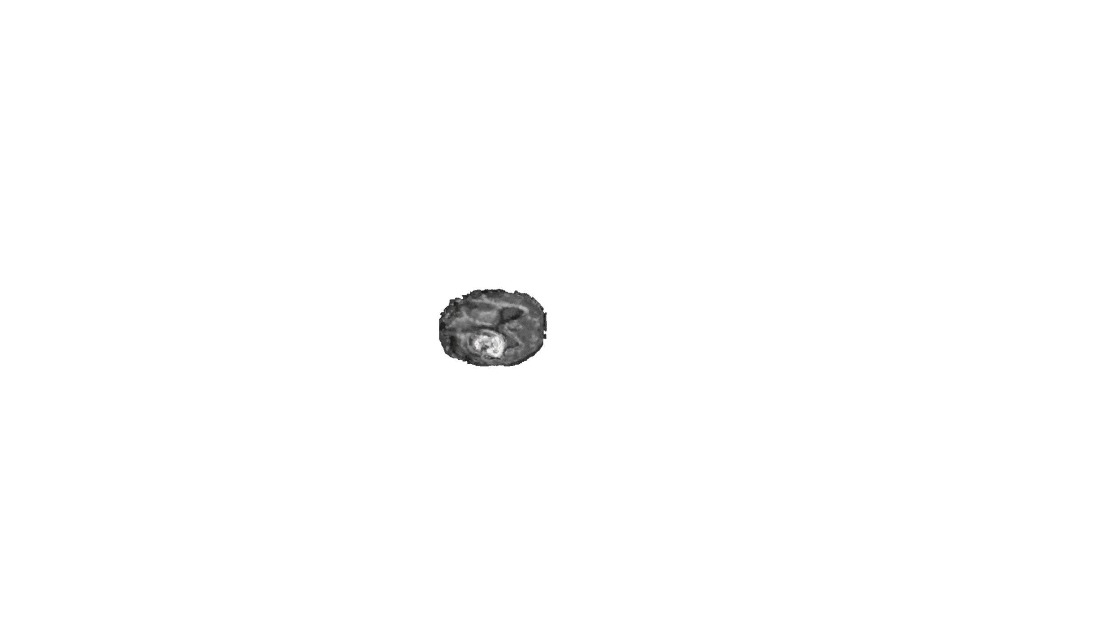
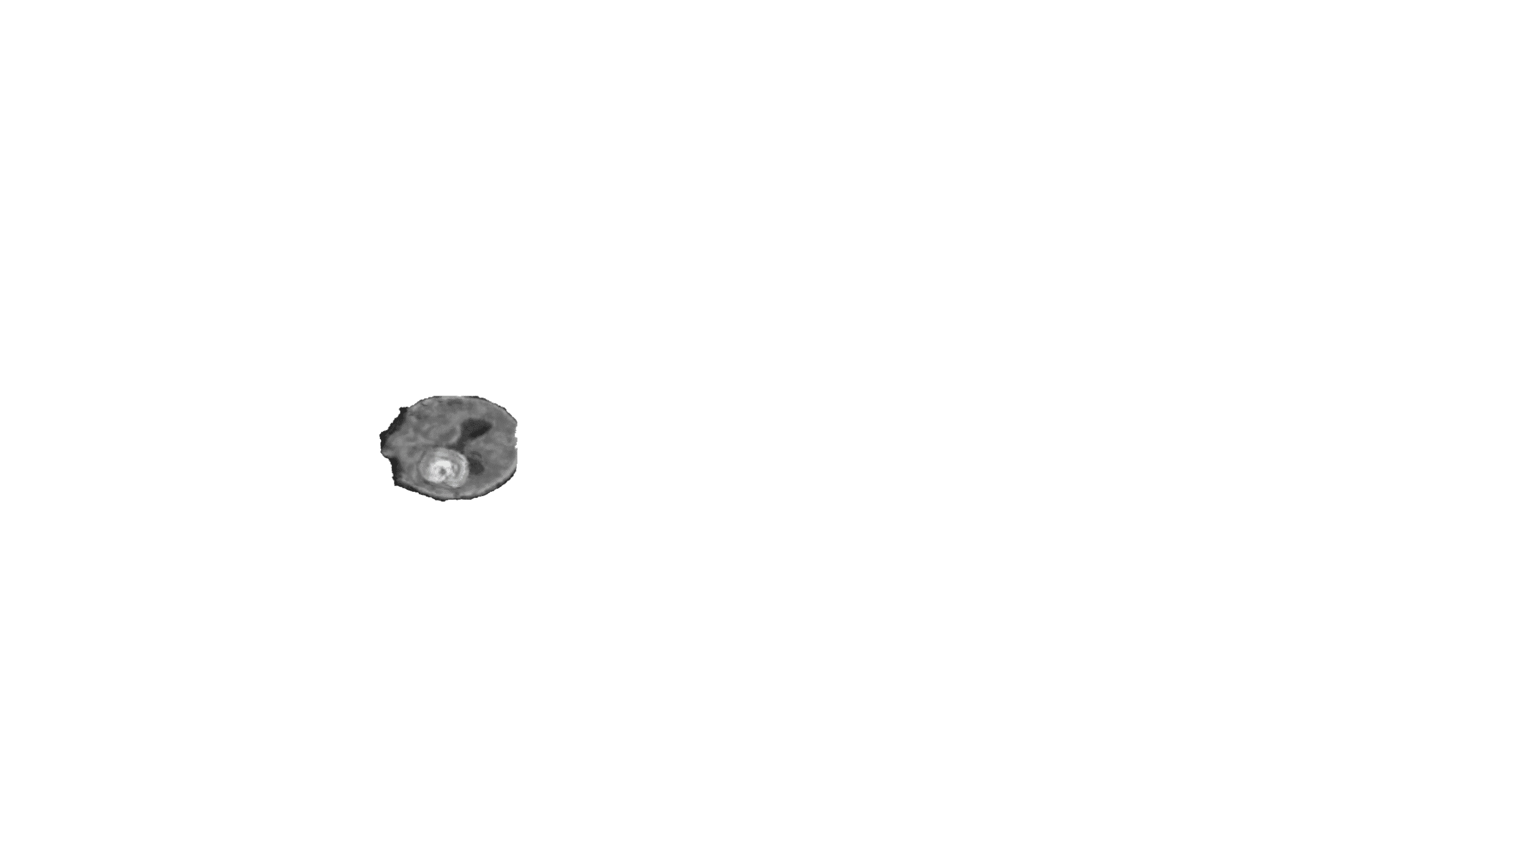
Extend to multiple sequences!
Flair
BRATS - T1
Brain atlas - BRATS
(inferred)
Brain + tumor
label (merged)
Synthetically
generated MRI
T2
Infer (G)
Merge
Infer (G)
MRI-to-label
Label-to-MRI
T1c
Tumor label - BRATS
(provided)
T1
1) No change
2) Shift location
3) Enlarge
4) Shrink
Flair
T2
Brain atlas - ADNI
(inferred)
Brain + tumor
label (merged)
Synthetically
generated MRI
ADNI - T1
T1c
Infer (G)
Infer (G)
MRI-to-label
Merge
Label-to-MRI
T1
Notes:
Brain tumor diagnosis is often done on multi-parametric MRI images, and we can extend the same framework to generate multi-parametric MRIs.

Slide 23
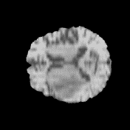
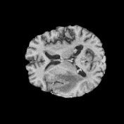
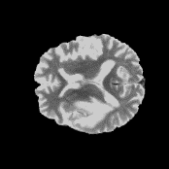
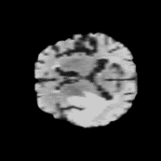
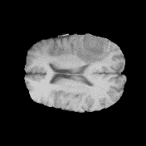
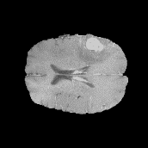
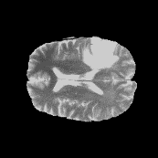
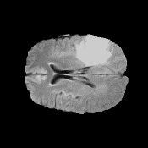
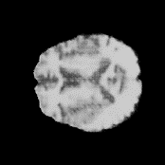































T1
T1c
T2
Flair
T1
T1c
T2
Flair
original
tumor mirrored
tumor 16% larger
tumor 16% smaller
tumor on normal
Notes:
Here we show some examples of generated multi-parametric brain MRIs with tumors. On the top row are original images and from the second row are synthetic images with tumor placed on the other side of the brain, tumor made a little larger or smaller , and tumor placed on an otherwise tumor-free brain. Please note on the third row right side example, when we make the tumor too large it can pop out of the head which is not realistic. We’ll have to have precaution on how we alter the tumor in order to have a realistic synthetic image.

Slide 24








































T1
T1c
T2
Flair
T1
T1c
T2
Flair
original
tumor mirrored
tumor 16% larger
tumor 16% smaller
tumor on normal
Notes:
Here we see some more examples.

Slide 25







This can be also a more advanced data augmentation tool
“way more advanced data augmentation”
“usual” data augmentation
“a bit more advanced data augmentation”
synthetic
Zoom & crop
Elastic deformation
original
Jennifer, but not too different
from the original
Not Jen anymore, if deformed too much
There’s so much you can do elastic deformation
flip
Elastic deformation
Still Jen, and can generate arbitrary many Jen images
with different attributes/characteristics!
synthetic
Notes:
We claim this can be an advanced data augmentation tool. The “usual” data augmentation methods are zoom, crop, or flip. But they are still the same images. The usual “advanced” data augmentation we often do in medical imaging is elastic deformation, but there’s only so much you can do with elastic deformation, because if you deform too much it’s not realistic any more. On the other hand, with synthetic image generation technique we can generate synthetic images with attributes we desire, and they’ll be realistic.

Slide 26




This can be an anonymization tool to more easily share the data
Build a 10,000 brain MRI scans dataset needed to train a well-performing AI!
Data are NOT isolated!
Share!
NO PRIVACY
Share!
NO PRIVACY
Share!
NO PRIVACY
…
Synthetic data
…
Synthetic data
…
GAN
GAN
GAN
Hospital A
Hospital B
Hospital C
…
…
…
Has 3,200 brain MRI scans
Has 5,000 brain MRI scans
Has 800 brain MRI scans
Notes:
Synthetic images are not really tied to any specific patients, so we hope they can be more easily shared across hospitals and clinical institutions, contributing to collect large medical image dataset representing enough diversity of the population. Also, because synthetic images are generated from labels we are free from the roadblock of the time-consuming process of annotating them. We hope this can contribute to democratizing medical AI. Not everybody can have lots of medical images and annotations to train performant AI but everyone can have lots of synthetic images and to train a performant AI.

Slide 27
Questions?

